Slide 1
Continuous Glucose Monitoring
Dr Paolo Actis
p.actis@leeds.ac.uk

Slide 2
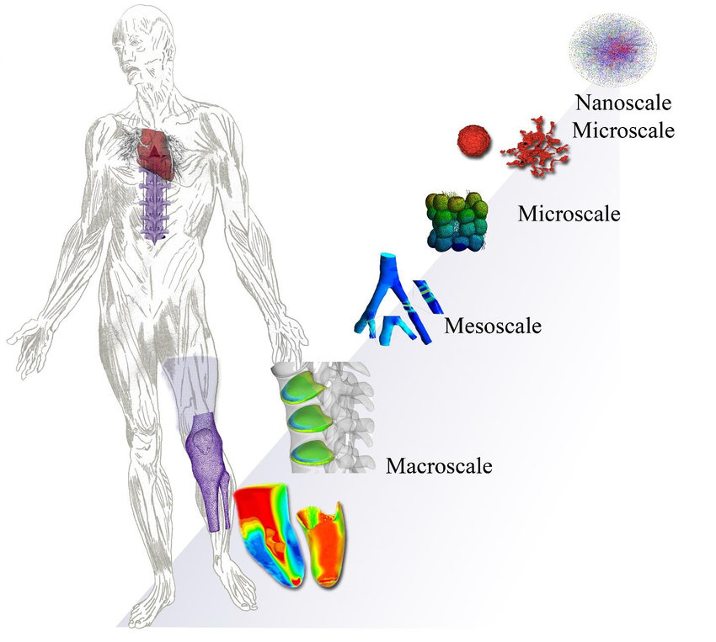
An electronics journey through the human body
Dernowsek et al, 2018, Biomechanics

Slide 4
Mole
One mole (mol) of potatoes contains 6.022 10²³ potatoes
Avogadro’s Constant: 6.022 10²³ mol⁻¹
Notes:
Chemists measure the amount of a substance in a unit called ‘the mole’. This is a convenient way of counting atoms.

Slide 5
Molarity (M)
Molarity (M): moles per unit volume
Example: 1M (one molar) = 1mol/L= 6.022 10²³ L⁻¹

Slide 7
Example
How many glucose molecules are present in a 10 μL blood droplet if the glucose meter reads 5.8 mM?

Slide 8
Solution
Moles=?
5.8 10⁻³ mol/L 10⁻⁵ L = 5.8 10⁻⁸ mol
5.8 10⁻⁸ mol 6 10²³ mol⁻¹ = 3.5 10¹⁶ glucose molecules

Slide 9
What if I want to measure
a cancer biomarker?
Notes:
Why not infectious diseases that accounts for ¼ of global deaths? Or malaria? Or kidney disease? Or alzheimer? Or stroke?

Slide 10
Source: The blood peptidome: a higher dimension of information content for cancer biomarker discovery,
Nature Reviews Cancer, 2006

Slide 11
Solution
Cancer biomarker 10⁻¹⁵ M
Moles=?
10⁻¹⁵ mol/L 10⁻⁵ L = 10⁻²⁰ mol
10⁻²⁰ mol 6 10²³ mol⁻¹ = 6 10³ biomarker molecules

Slide 12
 | Glucose | Cancer Biomarker
Concentration | 5 mM | fM
Number of molecules (10 µL droplet) | 3.5 10¹⁶ | 6 10³

Slide 13
Why Continuous Glucose Monitoring ?

Slide 14
Facts about Diabetes
Diabetes is a chronic disease that occurs either when the pancreas does not produce enough insulin or when the body cannot effectively use the insulin it produces. Insulin is a hormone that regulates blood sugar. Hyperglycaemia, or raised blood sugar, is a common effect of uncontrolled diabetes and over time leads to serious damage to many of the body's systems, especially the nerves and blood vessels.
Sources: WHO, 11/2021

Slide 15
Facts about Diabetes
Globally, 422 million adults were living with diabetes in 2014, compared to 108 million in 1980.
2. Diabetes caused 1.9 million deaths in 2019
3. CGM market valued at US$ 1.3bn in 2016
Sources: WHO, 11/2021

Slide 16
Because patients want it
Notes:
Why not infectious diseases that accounts for ¼ of global deaths? Or malaria? Or kidney disease? Or alzheimer

Slide 17
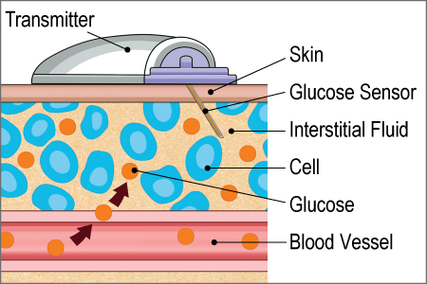
freeStyle Libre

Slide 18
Watch the Video on Minerva

Slide 19

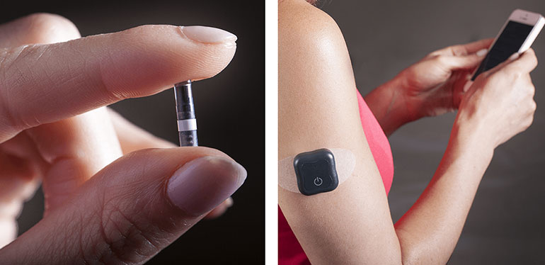
Eversense CGM
90 days of highly accurate CGM readings
Needs to be implanted by a medical professional
Optical Readout
On body vibe alerts
ACTUAL SIZE: 3.5 MM X 18.3 MM

Slide 20
Eversense CGM
Last year the FDA approved its use for 180 days
but

Slide 21
Eversense CGM
Last year FDA approved its use for 180 days
But
twice a day calibration with finger-prick test

Slide 22
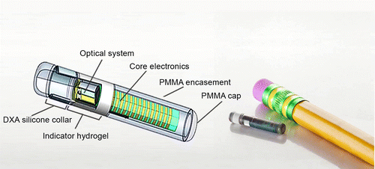
Eversense CGM
https://www.liebertpub.com/doi/10.1089/dia.2018.0028#

Slide 23
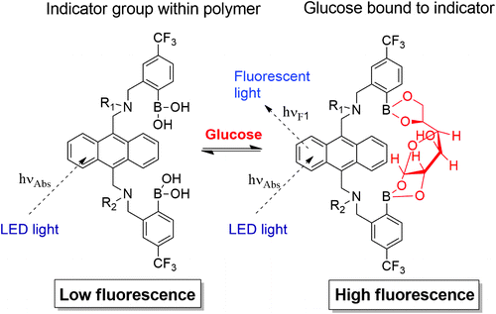
Eversense CGM
https://www.liebertpub.com/doi/10.1089/dia.2018.0028#

Slide 24
Start-up in CGM

Slide 25
profusa

Slide 26
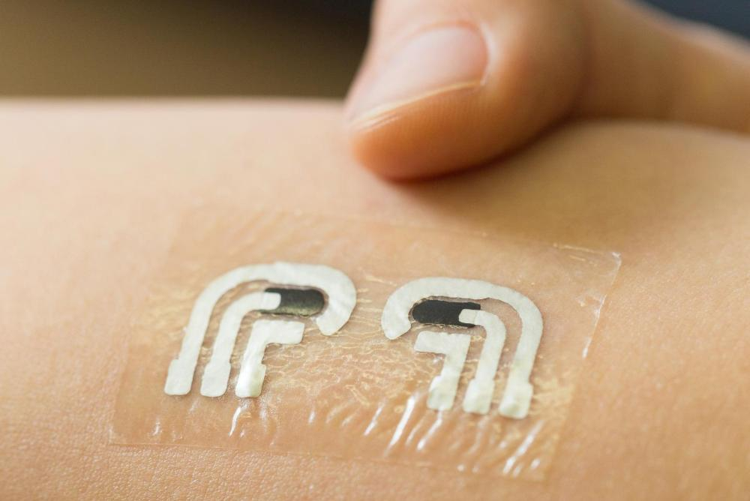
A tattoo CGM?

Slide 27
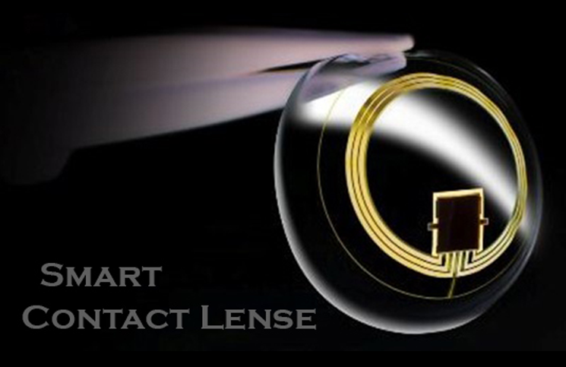
A contact-lense CGM?

